Slide 1

E-commerce site
Presented by Admond Tamang
Batch 21

Slide 2
Introduction
E-commerce is purchasing, selling and exchanging goods and services over internet.
The main purpose of e-commerce site is that any person can buy as well as sell products.

Slide 3
Goals
Help user find the specific products.
Sell their products and earn money.
Encourage local markets.
To reduce cost.

Slide 4
Features
Shopping cart
Checkout system
Payment system
Searching product
Browse through store

Slide 5
Advantage
Low cost
No checkout queues
Shop from anywhere

Slide 6
Disadvantage
Security issue
Product fault
Possibility of fraud.

Slide 7
Work Breakdown structure
E-commerce
Project Managment
Analysis
Design
Implementation
Testing
Risk Management
WBS
Configuration Management
Proposal Submission
Requirement Analysis
Structural Model
Build Database
Unit Testing
Analysis Specification
Use Case
Architecture
Behavioural Model
UI design
Database Design
Coding
Black box Testing
White box Testing
Integration Testing
Deployment
User Training
Final Report

Slide 8
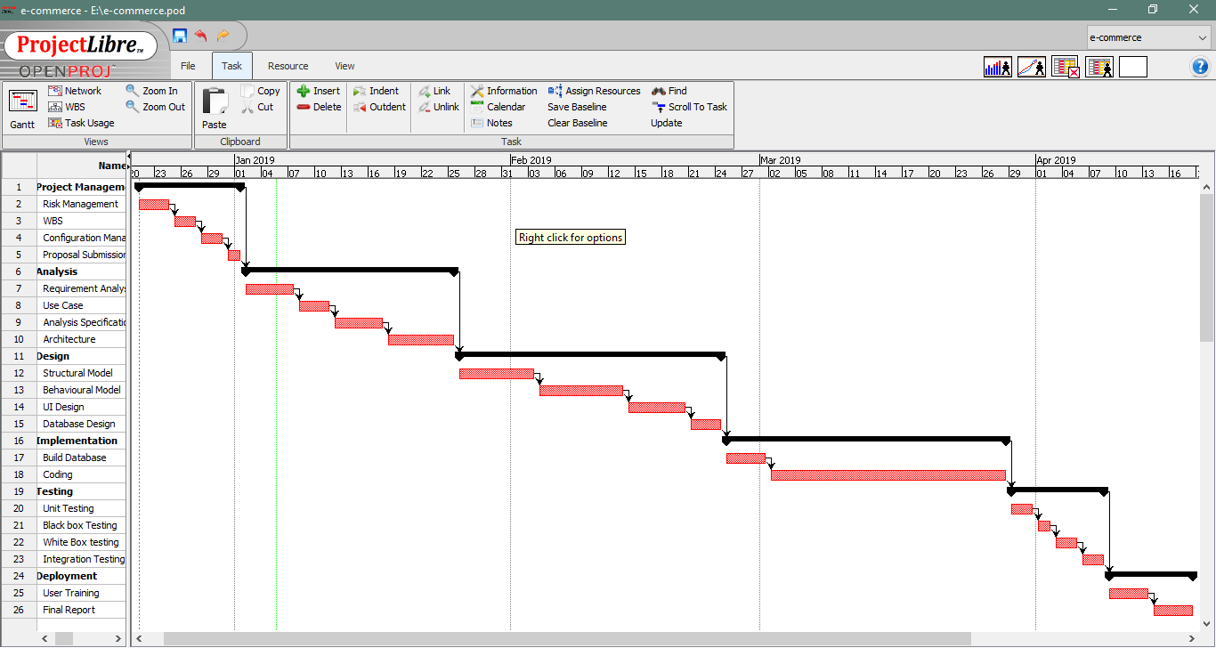
Gann Chart

Slide 9
Waterfall Methodology
Project Management
Analysis
Implementation
Design
Deployment
Testing

Slide 10
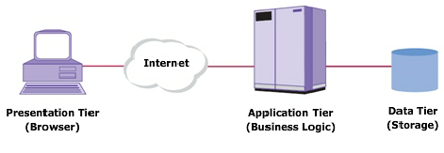
3-tier architecture
Presentation
Application
Data tier

Slide 11
Risk management
S. No | Risks | Likelihood | Consequences | Impact | Solution
 | Lack of staff training | 2 | 3 | 6 | At the stage of deployment, staff should be trained properly to use the system.
 | Data theft | 3 | 4 | 12 | Strong company policy should be established.
 | Failure to meet requirement | 2 | 4 | 12 | Proper planning is to be done in every phase.
 | DDOS attack | 1 | 4 | 4 | Placing the publicly exposed server in DMZ.
 | Database error | 1 | 5 | 5 | Analyze the data traffic and upgrade the hardware if necessary.
 | Server failure | 1 | 5 | 5 | IT security should be hired to look after the server.
 | Change in government policy | 1 | 5 | 5 | Should be aware about the situation of the country and make changes accordingly.

Slide 12
Configuration management
Github was used to manage my project.

Slide 13
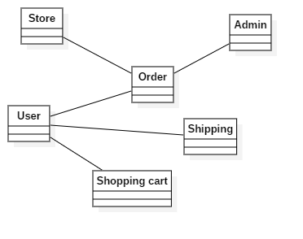
Design: initial Class diagram

Slide 14
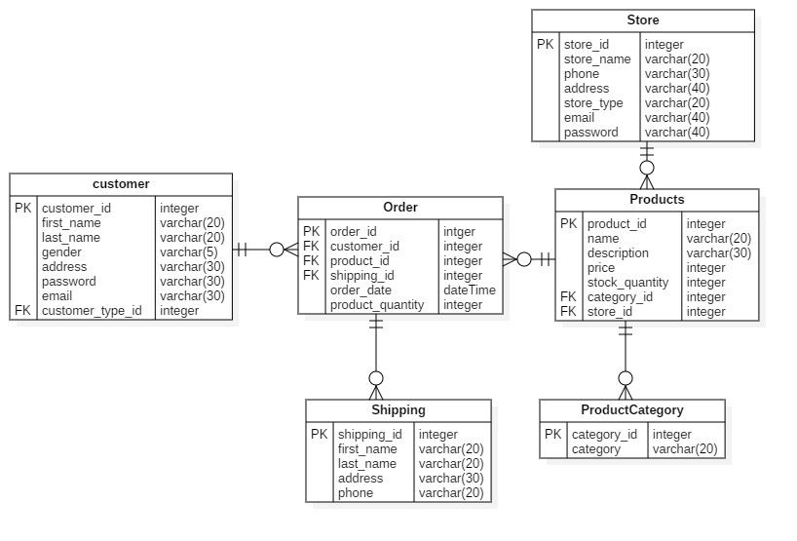
Er-diagram

Slide 15
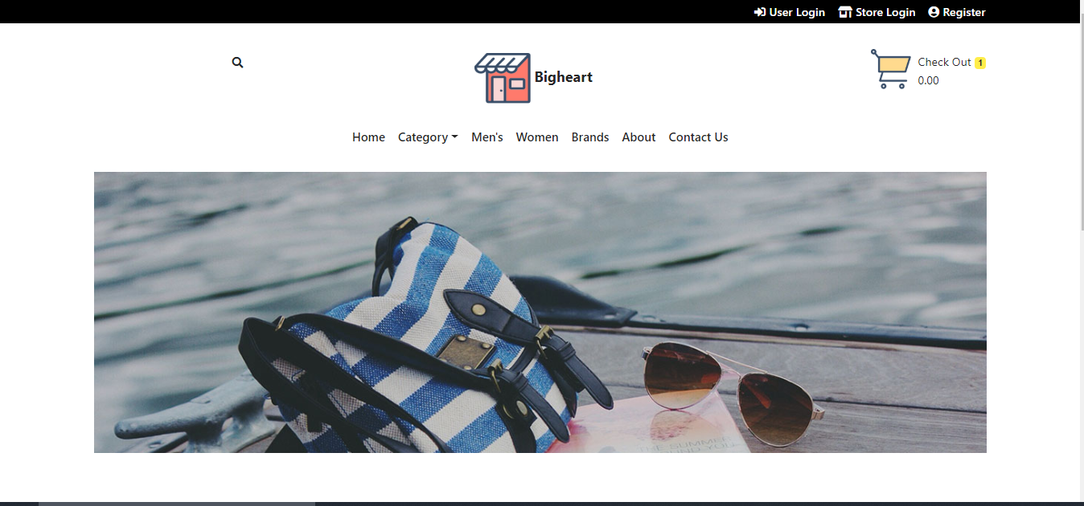
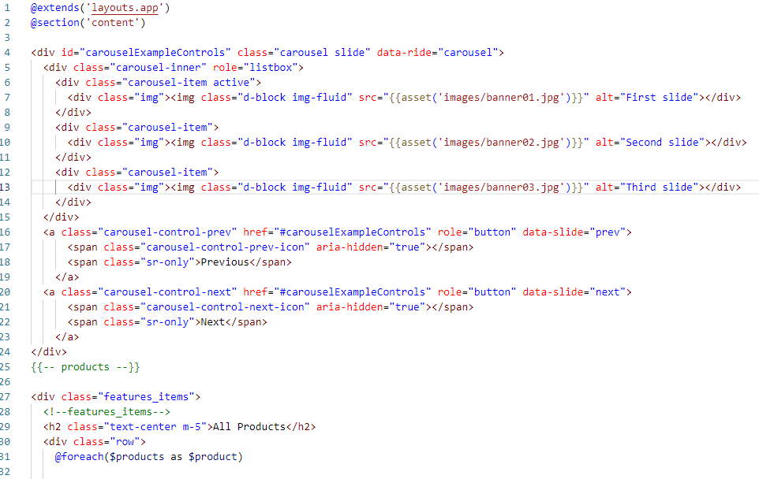
UI design and code

Slide 17
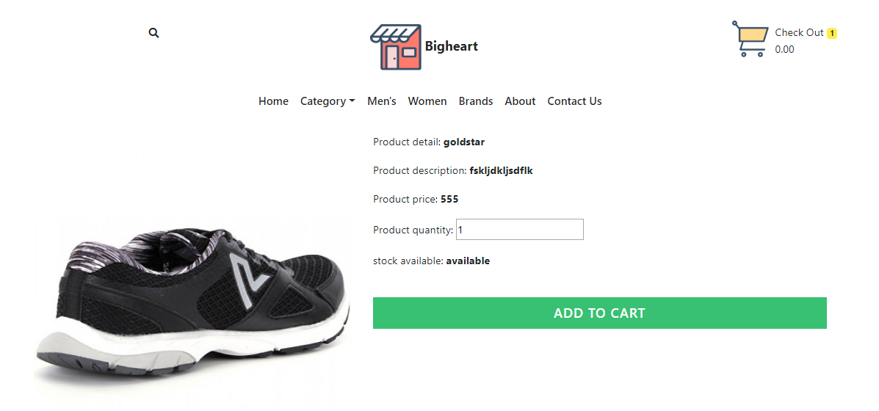

Slide 18
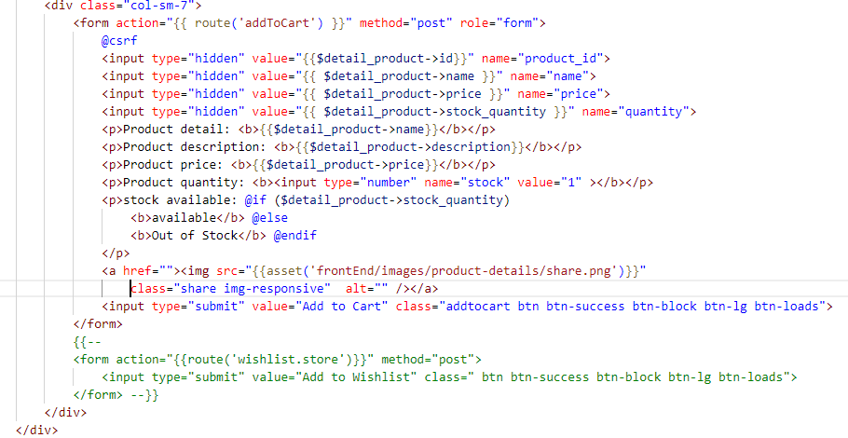

Slide 19
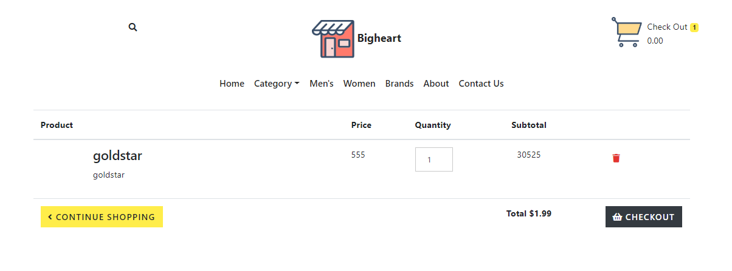
cart Ui

Slide 20
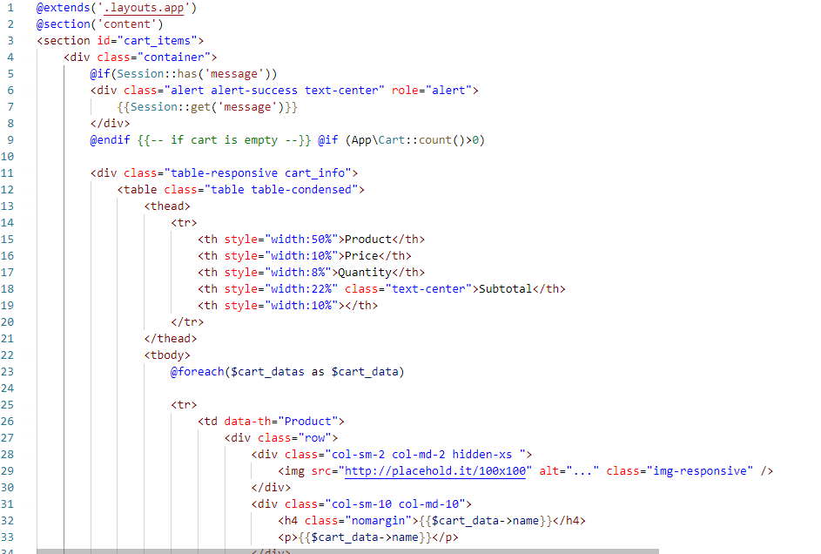
Cart code

Slide 21
LIMITATION
Delivery manages
Track products
Money protection
Payment system

Slide 22
Unit Testing
One test for one function.
Each method test one thing only.
Only one assert in one method.
Independent test. No data sharing between test.

Slide 23
Future work
Make payment system
User can sign up with social media like facebook, google etc
GUI modification for more interactive experience.

Slide 24
Conclusion

